Slide 1
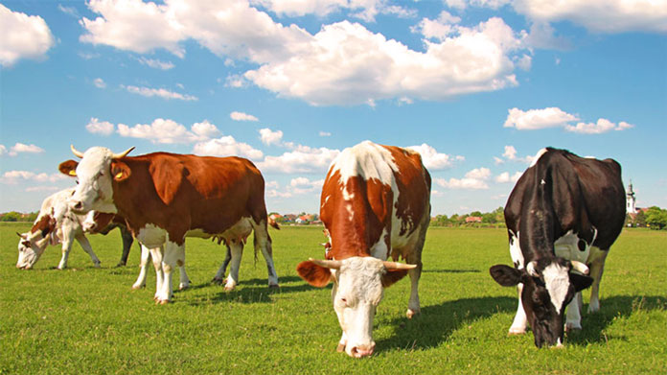
ANIMAL HUSBANDRY

Slide 2
Animal husbandry is the branch of agriculture concerned with animals that are raised for meat, fibre, milk, or other products. It includes day-to-day care, management, production, nutrition, selective breeding, and the raising of livestock

Slide 3

ANIMAL HUSBANDRY OF KERALA
Animal husbandry is the branch of agriculture concerned with animals that are raised for meat, fibre, milk, or other products. It includes day-to-day care, management, production, nutrition, selective breeding, and the raising of livestock

Slide 4
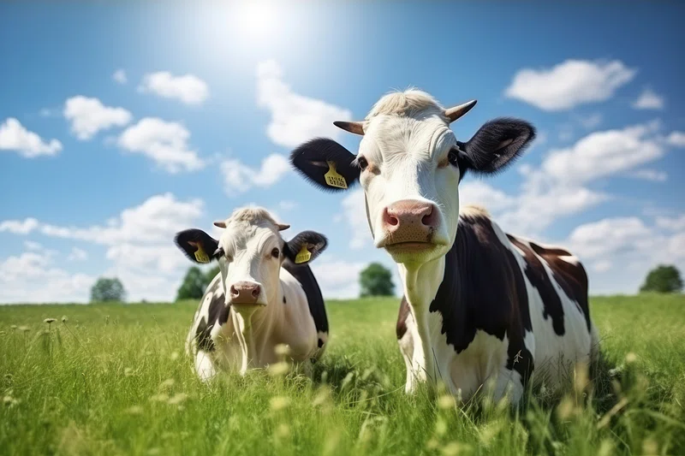
CATTLE BREEDS

Slide 5
Cattle Breeds
Vechur
Kasaragod dwarf
Kuttampuzha dwarf
Vilwadri

Slide 6
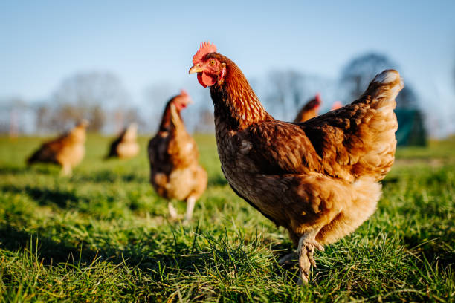
POULTRY
BREEDS

Slide 7
Poultry Breeds
Gramalakshmi
Gramapriya
Athulya
Thalassery
Chicken

